Slide 1
End of Year Reflection Session
Single Subject Program
2017

Slide 2
10-10:30 REFLECTION
Pull out a piece of paper.
Take 5 minutes to write answers:
3. Identify 3 AHAs or takeaways from program.
2. Identify 2 recommendations you would have for incoming candidates.
1. Identify 1 suggestion for program improvement.
When done, share responses with your neighbors.
Notes:
10-10

Slide 3
10:30-11:15 Complete the following:
1. Supervisor Evaluations: Go to e-mail
2. Annette has invited you to fill out the:
SURVEY Form - Leading and Learning: Supporting English learners with effective teacher preparation and professional development.
https://goo.gl/forms/086nuu5JPtUYLWUV2
3. Speak Up Survey
http://www.speakup4schools.org/TomorrowsTeachers/
4. Update your contact info
https://docs.google.com/spreadsheets/d/1sBi5KJKDJV7T0AFM3YDqK2AC29mMVdzPkz4YibVzByo/edit?usp=sharing
5. Add Action Research Data if you haven’t yet
https://docs.google.com/forms/d/e/1FAIpQLSfNsmRGi5SH-loKKpmQH7Xld8L2l8iHjH5WvSphSQpds0R_Bg/viewform?c=0&w=1
6. Prerequisite Survey
https://goo.gl/forms/cMi573Gc1c7GvTOp1
7. Carlsbad Gender Sexuality Alliance Thank You Cards
8. Remember MA in Ed Applications are due May 31, 2017:
https://www.csusm.edu/cehhs/studentservices/admission/howtoapplyma.html

Slide 4
11:15-11:20 Commencement & Celebration
Saturday, May 20th
1:30-2:45 SOE Celebration USU Ballroom
4pm CEHHS Commencement on Field
If you want to participate in commencement register now:
http://www.csusm.edu/commencement/graduates/participationform.html.
For more information regarding commencement: http://www.csusm.edu/commencement/

Slide 5
11:20 – 11:35 Myriad of Interviews
Expert panel of Interview Experts from around the area will describe the various types and focus of interviews around the state and beyond.

Slide 6
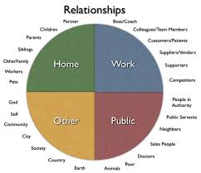
Professionalism & Relationships
Interviews are just the
beginning.
You begin with
professionalism
In the interview and
build relationships
with parents, students,
and colleagues.
Find colleagues who
are as enthusiastic as
you.

Slide 7
Last August, we met for
the first time. Do you remember some of the first things we did? We focused on …..
Relationships: Name Game, True Colors
Professionalism: Clear expectations
Hint…..this would be a good way to begin in your own classroom.

Slide 8
TPE 12 Professional, Legal and Ethical Obligations
Teachers … take responsibility for student academic learning outcomes. They are aware of their own personal values and biases and recognize ways in which these values and biases affect the teaching and learning of students. They resist racism and acts of intolerance.
Notes:
1:30 (5 min.)
*

Slide 9
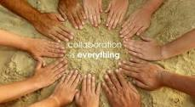
Professional Dispositions: Collaboration
Teachers practice the skills of collaboration in their professional interactions with instructors, advisors, students, colleagues, parents/guardians/caregivers and those in the wider community.
Teachers consistently interact with others (students, parents, colleagues) in ways that communicate respect….. Clearly values and builds relationships.

Slide 10
Disposition: Professional Ethics
Act on well-reasoned, principled judgments.
Consistently honor the needs and best interests of students, the work setting (school, district, university), and the profession.

Slide 11
CTC Code of Conduct
http://www.ctc.ca.gov/credentials/rules-of-conduct.html
NEA Code of Ethics
https://www.nea.org/home/30442.htm
Notes:
1:35

Slide 12
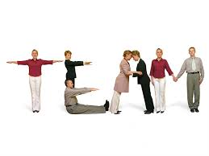
TEAMWORK One more thing to remember: Human Capital and Collaboration: The Smartest Person in the room IS the room.

Slide 13
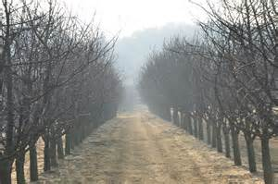
Social Justice & Equity
Continue your journey to grow in cultural competence.
It is never ending….
Notes:
Afterward share video (15 minutes) and then Lori for credentialing 12 -1 pm.

