Slide 1
Using ELD Standards to Teach High School English Learners Vocabulary
Annette Daoud
Anne René Elsbree
Julie Rich
California State University, San Marcos
CABE Annual Conference, March 30, 2017
Work supported by US Department of Education, Office of English Language Acquisition (OELA) grant

Slide 2
Objective & Ticket Out the Door
CONTENT OBJECTIVE (What)
After candidates participate in 2 different vocabulary activities, candidates will be able to design a vocabulary activity with content standards, ELD standards, language objective, content objective and materials.
LANGUAGE OBJECTIVE (How)
After reviewing the vocabulary terms from weeks 1-3, candidates will be able to plan and deliver an oral and visual presentation on their assigned vocabulary terms using appropriate understanding of register.
TICKET OUT THE DOOR - Vocabulary Activity with the following:
Content & ELD Standard
Language & Content Objective
Condition, Action Verb and Criteria
Materials
Notes:
+10 min = 20 minutes

Slide 3
4 Square (Frayer) Vocabulary Graphic Organization
WORD & DEFINITION | PICTURE
NON-EXAMPLE | EXAMPLE LIST

Slide 4
4 Square (Frayer) Vocabulary Graphic Organization
ACADEMIC LANGUAGE Language used in school to help students develop content knowledge. It includes general academic vocabulary (e.g., infer, evaluate) as well as content specific vocabulary (e.g., calculate, hypothesize) | PICTURE (insert picture)
NON-EXAMPLE totally awesome OMG | EXAMPLE LIST Analyze Interpret Justify investigate

Slide 5
4 Square (Frayer) Vocabulary Graphic Organization
WORD & DEFINITION | PICTURE
NON-EXAMPLE | EXAMPLE LIST

Slide 6
Gallery Walk
Walk around the room and
review the definition for each vocabulary term.
Take your original vocabulary review sheet with you to add ideas and notes AND “Post, Snap & Slide”

Slide 7
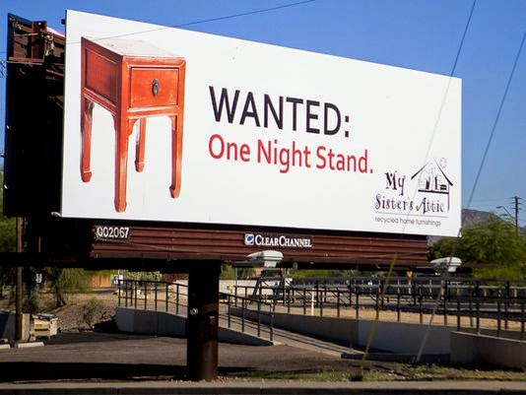

Slide 8
New Vocabulary Terms Design Billboards
Assessment
Central Focus
Commentary
Instructional Tasks
Learning Objective
Learning Tasks
Planned Supports
Prior Academic and Prerequisite Skills
Variety of Learners
Notes:
+ 10 minutes = 1 hour 5 minutes

Slide 9
Inside/Outside Circle Roles
Number your Billboards A-D & assign reporters for each billboard – If there are more than 4 people per group you may double up.
Letter A Inside Circle for Group #1
Letter B Outside Circle for Group #1
Letter C Inside Circle for Group #2
Letter D Outside Circle for Group #2
Notes:
+ 5 minutes = 1 hour 10 minutes

Slide 10
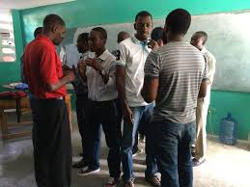
The Process
Inside Circle Members – Make a circle facing outward with shoulders touching.
Outside Circle Members - Make a circle facing the inside circle members.
There should be 9 inside billboard teams facing 9 outside billboard teams.
Inside circle stays put and goes first.
Outside circle rotates clockwise when light flickers.
Face the direction you would rotate to check.
Rotate when the light flickers.
Notes:
+20 minutes = 1 hour 30 minutes

Slide 11
Design a Vocabulary Lesson (Summative Assessment)
Identify Vocabulary Words
Choose Vocabulary Activity
Choose Content & ELD Standard
Language & Content Objective
Condition, Action Verb and Criteria
5. Choose Materials
Notes:
+ 30 minutes = 2 hours

Slide 12
Using the California ELD Standards in an Assessment Plan
Each ELD Standard represents a language skill that ELs need in order to become proficient in English
SDAIE lesson = Content AND English language development
A SDAIE lesson has 1 assessment plan that includes:

Slide 13
Using the California ELD Standards in an Assessment Plan
What proficiency level of the ELD Standard
do you choose for your SDAIE lesson?
i + 1 or one level above the current proficiency level of your English learner(s)
Use the wording of each level of the ELD Standard (Emerging, Expanding and Bridging) to create a rubric to assess language development
Aligned to your language development objective

Slide 14
Creating Rubrics Using the California ELD Standards
English learners in the class: 20 LTEL students
Language Development Objective (Bridging):
After a close reading, students will be able to write a clear and coherent summary of (name of text) using complete and concise sentences and key words (vocabulary).
ELD Standard: Writing (b). Summaries (Grades 9-10)
Emerging | Expanding | Bridging
10. Writing b) Write brief summaries of texts and experiences using complete sentences and key words (e.g., from notes or graphic organizers). | 10. Writing b) Write increasingly concise summaries of texts and experiences using complete sentences and key words (e.g., from notes or graphic organizers). | 10. Writing b) Write clear and coherent summaries of texts and experiences using complete and concise sentences and key words (e.g., from notes or graphic organizers).

Slide 15
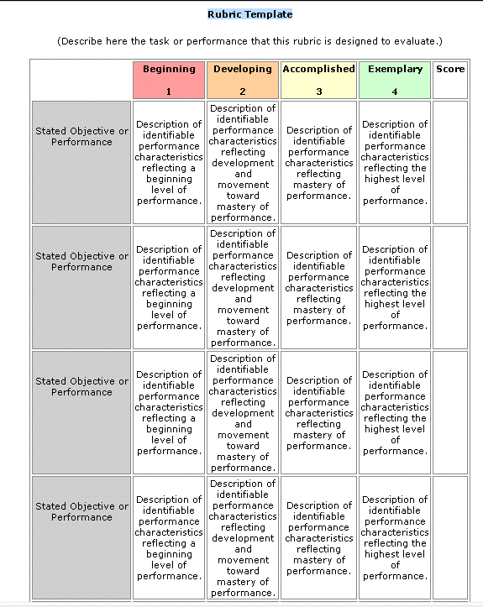
Creating Rubrics Using the California ELD Standards
Language Development Objective (Bridging):
After a close reading, students will be able to write a clear and coherent summary of (name of text) using complete and concise sentences and key words (vocabulary).
Rubric to assess language development and content (4 = Bridging)
 | 1 | 2 | 3 | 4
Written Summary (Language Development) | Summary was brief, had one complete sentence using one vocabulary word | Summary of (content) was brief, had 2 complete sentences using 2 vocabulary words | Summary of (content) was concise, had 3 complete sentences using 3 vocabulary words | Summary of (content) was clear and coherent, had 4 complete and concise sentences using 4 vocabulary words
(Content)
Notes:
+30 minutes (2 hours)

Slide 16
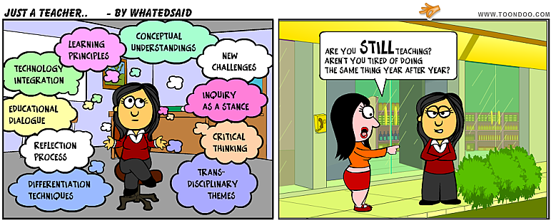
Ticket Out the Door
Vocabulary Activity with:
Content & ELD Standard
Language & Content Objective
Condition, Action Verb and Criteria
Materials
Notes:
2hours +

Slide 17
THANK YOU!!
Annette Daoud adaoud@csusm.edu
Anne René Elsbree aelsbree@csusm.edu
Julie Rich jrich@csusm.edu
Pat Stall pstall@csusm.edu
School of Education
California State University San Marcos
CSUSM Single Subject Program Website Resources: http://csusmsinglesubjectprogram.weebly.com/
Social Justice and Equity
Coursework
Dispositions
Collaboration
Clinical Practice
Digital

